Slide 1



An Autonomous Institution
Department of Artificial intelligence and Machine learning Engineering
INNOVATIVE ASSIGNMENT-1
ENGINEERING GRAPHICS-25HME01IT
PRRSENTED BY BATCH NO: 19
VH15225 - VEMULA HARISH
VH15202 - VIJAY D A
VH15145 - VINISHA CHRISTEENA J
Biotech,
Chemical,ECE &IT
SUBJECT TEACHER: DR.NAGESWARI Assistant Professor/Dept AIML | Head of the Department MR.PRADEEP KATTA

Slide 2
QUESTION:
Coir is unwound from a drum of 30 mm diameter. Draw the
locus of the free end of the coir for unwinding through an
angle 720 degree. Draw also a tangent and normal at any point
on the curve

Slide 3
Introduction:
When a coir or string is unwound from the surface of a circular drum, the free end of the coir traces a curve known as the involute of a circle. This curve is important in engineering applications such as gear tooth design, cable winding, and mechanism analysis. The study of this curve helps to understand the motion of unwinding threads from cylindrical surfaces. In this experiment, we trace the locus of the free end of a coir as it is unwound from a drum through a total angle of 720 degrees.
Objective:
Draw the locus of the free end of a coir unwound from a drum through 720°.
Draw a tangent and normal at any point on that locus.
Provide the required presentation sections: introduction, objective, problem statement & given data, step-by-step procedure, conclusion, and references.

Slide 4
Problem statement:
Coir is unwound from a drum. Draw the locus of the free end for unwinding through an angle of 720°. Also draw a tangent and normal at any point on the curve.
Given data:
Drum diameter = 30 mm.
Drum radius = 15 mm.
Unwinding angle = 0° to 720° (two full turns).

Slide 5
Procedure:
Draw a base circle of radius 15 mm representing the drum.
2.Mark the starting point where the coir begins to unwind.
3.Divide the circle into equal angles up to 720°.
4.At each division point, draw a tangent to the circle.
5.On each tangent, measure and mark the arc length equal to the length unwound from the circle.
6.Join all the marked points smoothly to obtain the involute curve (locus).
7.Draw a tangent and normal at any selected point on the involute.

Slide 6
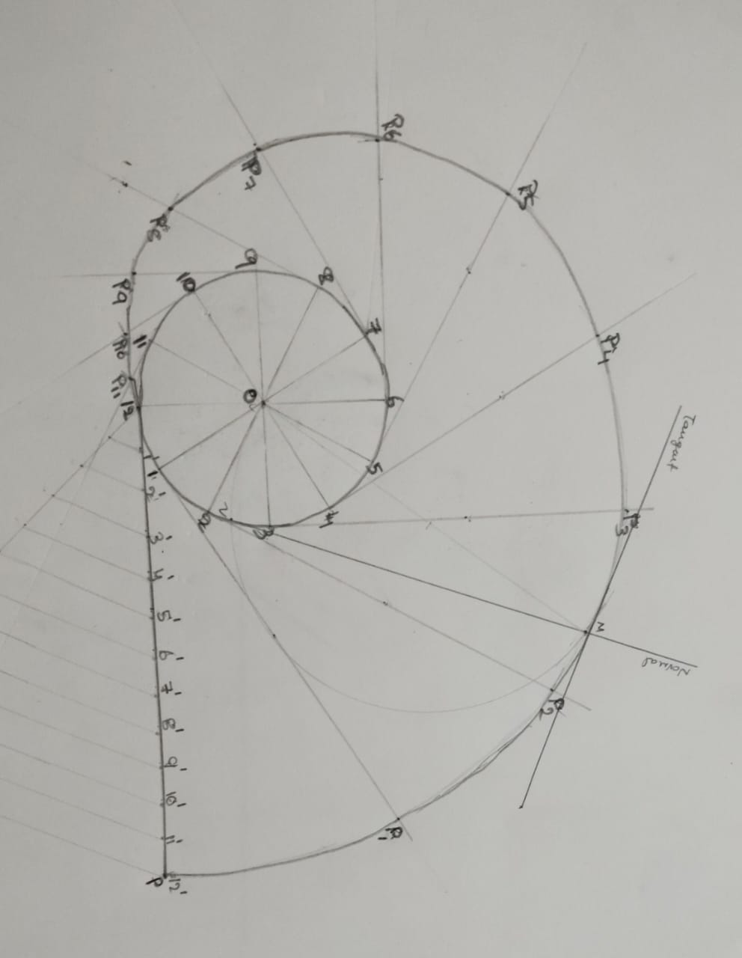
DIAGRAM:

Slide 7
Conclusion:
From this experiment, the locus traced by the free end of the coir unwound from a 30 mm diameter drum is found to be an involute of a circle. The tangent and normal drawn at any point on the curve help in understanding its geometric properties. This curve has practical applications in gear tooth design, winding mechanisms, and engineering drawings. The graphical method effectively demonstrates the generation of the involute curve through simple geometric construction.
References:
N.D. Bhatt, “Engineering Drawing,” Charotar Publishing House.
2.K. Venugopal, “Engineering Drawing and Graphics,” New Age International Publishers.
3.K.L. Narayana & P. Kannaiah, “Engineering Drawing,” Scitech Publications.

Slide 8


